Slide 1
Virtual Laboratory for Leveraging Technology for Bridges and Constructed Systems Federal Highway Administration Exploratory Advanced Research Program FHWA Program Management: Dr. Hoda Azari | Director, FHWA NDE Laboratory Dr. David Kuehn| Team Director/Program Manager, EARP Turner-Fairbanks Highway Research Center
Drexel University:
Charles Young, Stylianos Livadiotis
Matteo Mazzotti, Shi Ye, Qiang Mao
Michelle Burnworth
Rutgers University:
John Braley, John DeVitis
Emin Aktan, Coordinator
Ivan Bartoli, NDE
Kurt Sjoblom, Geoengineering and Foundations
Marcello Balduccini, Computer and Information Science
Franklin Moon, Accelerated Testing and SHM

Slide 2
Background:
There is a growing consensus on the need to transition to data driven objective decision making in the realm of managing highway infrastructures (US Congress, FAST Act; FHWA Strategic Plan).
Achieving this will require designing experiments using sensing, imaging, simulation and information technologies to obtain, visualize and interpret quantitative performance data from operating bridges.
Effective technology leveraging requires proper policy and strategy, also presupposes a profession with the requisite education/training. It also requires technology tools such as sensing, imaging, data processing, simulation and data-and-heuristics based decision-making.
The single most critical prerequisite is the championship of forward thinking bridge owners/engineers/managers willing to try new tools in partnership with academe and industry.
Notes:
Project follows from the requirement for more data driven decisions for highway infrastructure
Need quantitative from experiments, etc.
To do this we need the tools to do so
As well as the cooperation of bridge owners/managers
Need them to take a chance… provide confidence

Slide 3
The Problem
Discovery of Physical Phenomena
Application to Engineering Problems
Development of Technology
?
Research Community
Identification of Problem
Technology Selection and Implementation
Interpretation and Decision Making
A large number of technology tools are available for off-the-shelf purchase or application.
However, there are very few institutions that offer an ability for an integrative leveraging of such tools and the resulting data in conjunction with engineering heuristics for meaningful, feasible and effective solutions to infrastructure performance problems.
Asset Managers (via industry engineers)
Notes:
Often the NDE and SHM activities occur in two separate domains
The research community is principally involved with developing the technologies, and for decades have been contributing to a catalogue of technological solutions.
The bridge owners and managers implement the technologies to meet their infrastructure needs
The issue is how do the bridge managers and owners select the appropriate tools and ensure they are implemented correctly and effectively.
And how can the resulting data and results be turned into actionable decisions

Slide 4
Primary Deliverable:
The overarching goal of this project is to create an interactive virtual laboratory environment that will…
Permit users to explore various NDE and SHM technologies in a holistic manner - inclusive of tool selection, integration, data collection logistics, data processing, visualization, and interpretation.
Offer realistic case studies that expose users to scenarios related to the need, design and deployment of various NDE and SHM applications for solving real bridge performance problems.
Provide a platform for the development of training and certification programs for the deployment of NDE and SHM technologies.
Serve as a virtual meeting place for the NDE and SHM community.
Notes:
The Virtual Lab attempts to fill that need… essentially curating the NDE/SHM field for the owners/manager
Providing an environment to train and educate the direct users of NDE/SHM technologies (technicians, engineers, etc.) as well as the decision-makers that will integrate technology deployments within their management practices (to better meet agency goals).
In addition…
The Virtual Lab also offers the ability to develop universal certification programs to enhance QC related to technology applications.

Slide 5
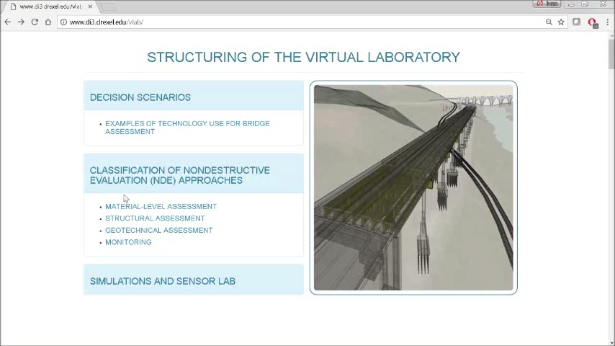
YouTube Video Link
Notes:
This is a mock-up of the envisioned gateway to the Virtual Laboratory website. To provide some structure the website is organized into three areas that represent the different users and their distinct ways of interacting with the website.
Decision-makers can enter the website through the “decision scenarios” pathway that would present realistic scenarios (inclusive of goals, constraints, etc.) to illustrate the potential trade-offs and strategies that can be employed when contemplating a technology deployment. There will also be case studies, whereby previous applications of NDE and SHM technologies have been applied to help answer questions of specific pieces of infrastructure.
Second, the technical details associated with the four primary categories of NDE approaches is provided. This will include general descriptions of various methods within each category (with references to the NDE Web Manual), interactive lab experiments, and interactive field applications.
Third, the “Simulation and Sensor Lab” pathway provide technical details for the various tools and methods as a reference for all users, in the form of generalized specifications and foundational theories.

Slide 6
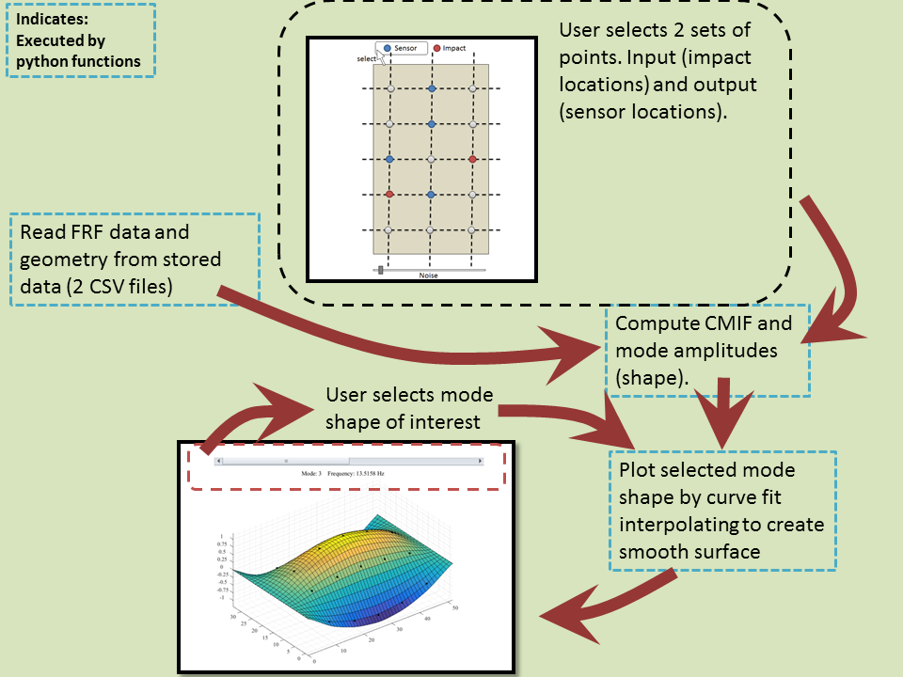
Interactive Impact Testing
Notes:
The structural assessment section of NDE approaches will feature several interactive modules that will give users a taste of SHM testing.
Allowing them to make the decisions (such as where to place sensors) and then to see how those decisions affect the test results and conclusions.
This is simple diagram, describing how one such module, featuring multi-reference impact testing, would be implemented.
Explain…

Slide 7
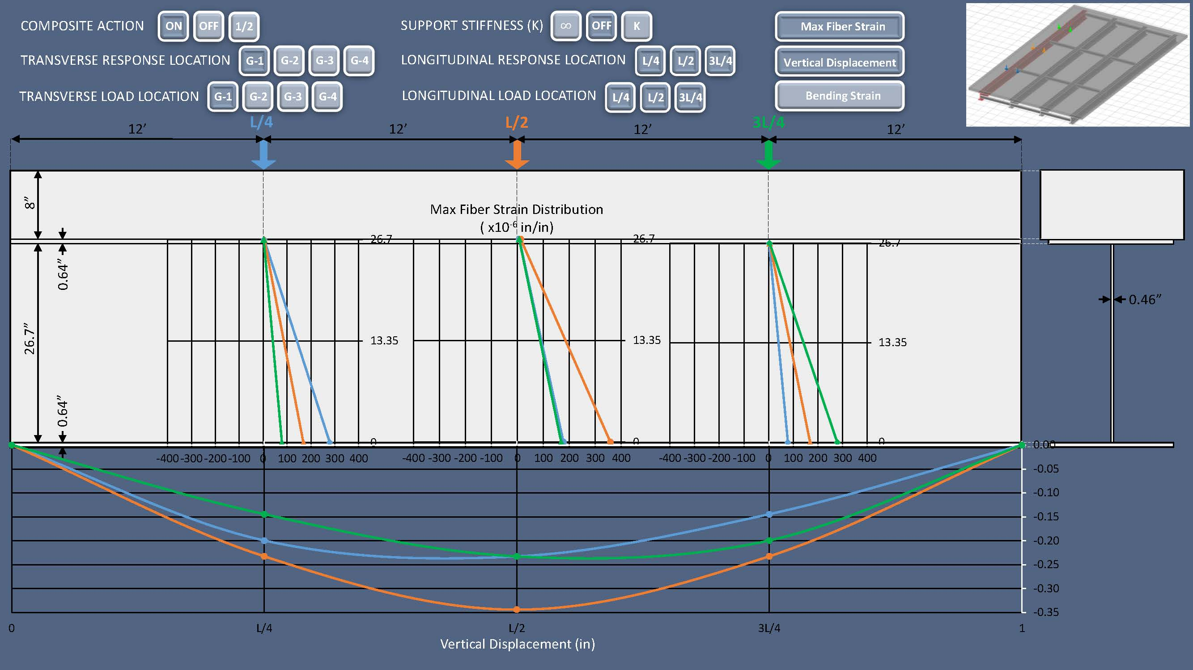
Interactive Load Test
Notes:
Another SHM module being developed features a virtual load test. Users can select bridge condition features (such as loss of composite action) and observe how those conditions would be reflected in the strain and displacement measurements.
In this way, we hope users can begin to develop an intuition for these SHM applications: the type of data obtained, the shortcomings, the importance of informed test decisions (e.g. appropriate sensor location and spatial resolution), and some of the pitfalls that should be watched for.

Slide 8
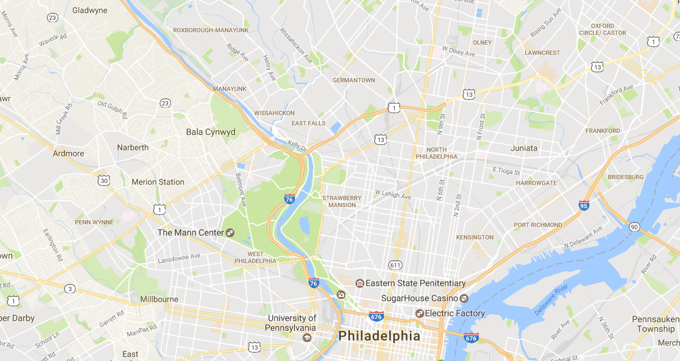
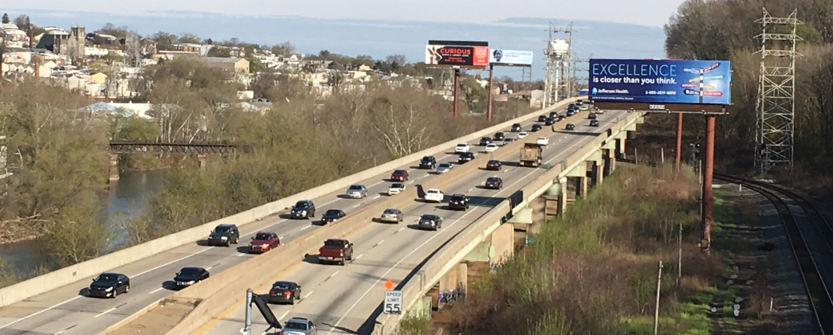
Case Study 1: Complementing Visual Inspection with Technology Tools and Heuristics for Bridge Condition Evaluation and Asset Management
I-76 PENCOYD VIADUCT
Case Studies of Technology Leveraging to Address Bridge Performance Concerns
Notes:
And now I will switch gears a little, to just one of the case studies that will be included in the website, the research for which is still in progress.
To give some quick background, this bridge was brought to out attention by the local DOT, who reported that they regularly received complaints from motorists about the high levels of vibration of the bridge.
We subsequently performed several monitoring efforts. To understand the nature of the vibrations, characterize the structure, and ultimately better understand why this was happening

Slide 9
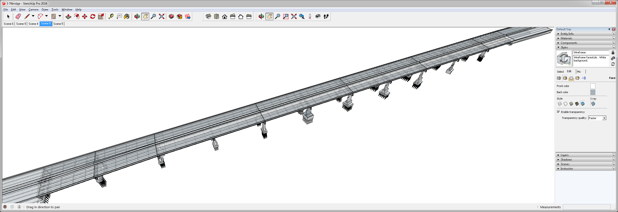
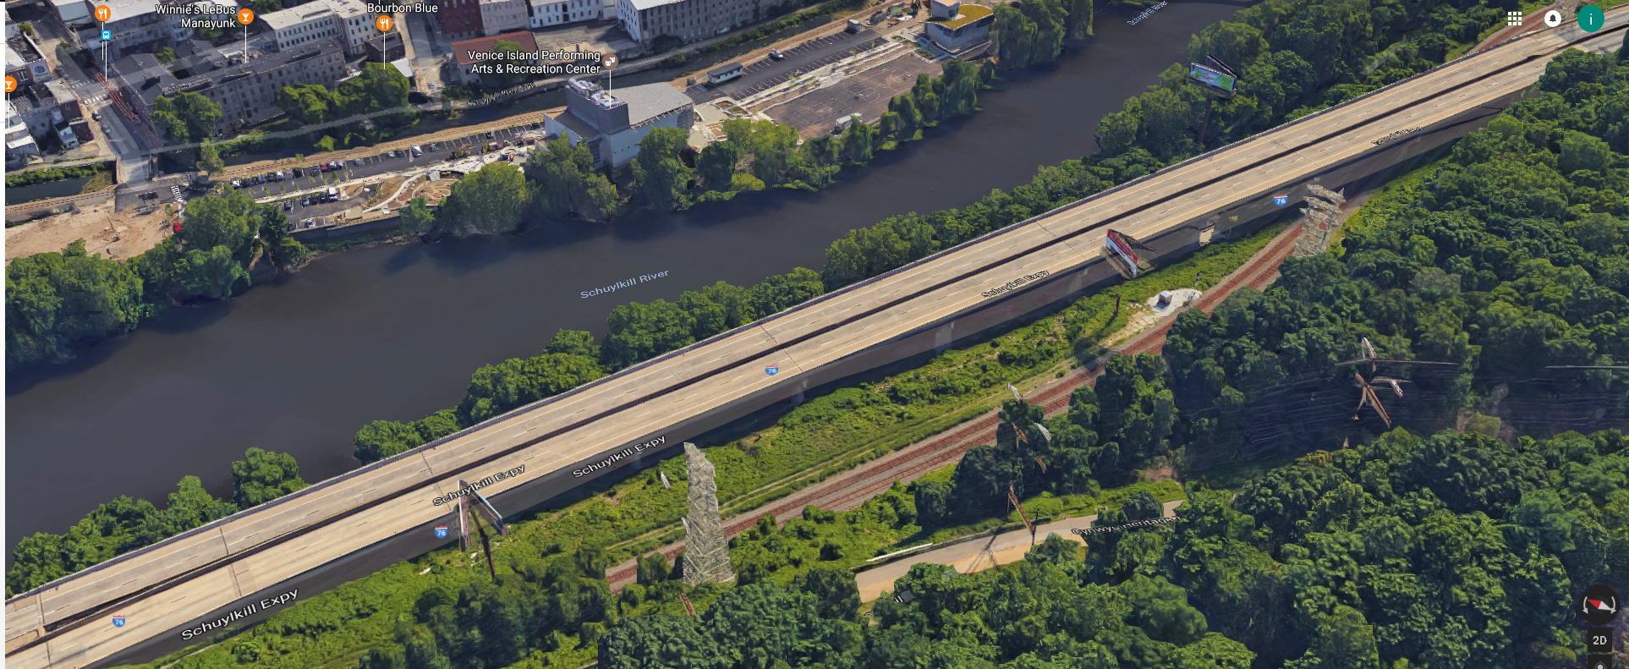
I-76 PENCOYD VIADUCT
Span 7
Scenario: Many complaints from drivers regarding severe vibrations
Span 10
Span 8
Span 9
Span 6
Span 7
Span 4
Span 5
Span 2
Span 3
WESTBOUND
EASTBOUND
Span 1

Slide 10
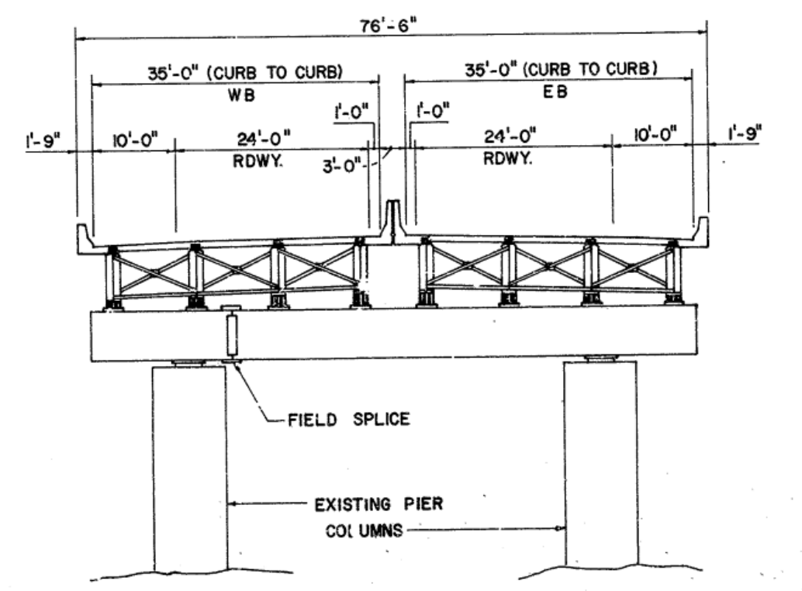
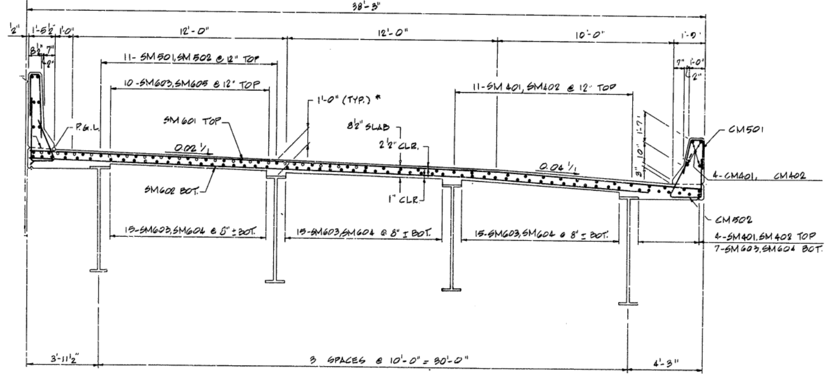
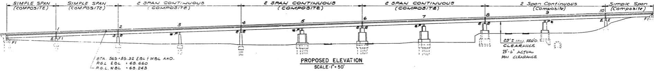
I-76 PENCOYD VIADUCT (1986)
Half section Span 7 and 8
Cross section
Elevation

Slide 11
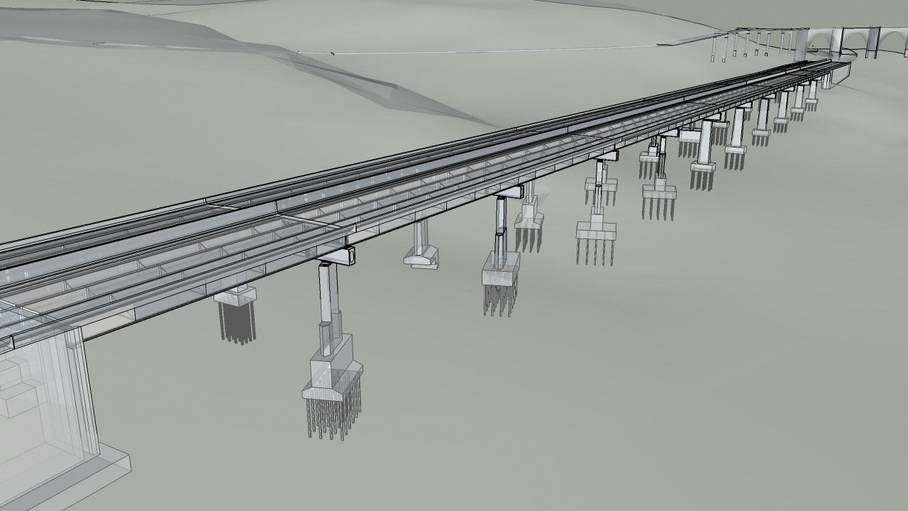
Example of SHM application in the Field
Vibration Investigation of multi-span viaduct
The viaduct was first constructed in 1952. The superstructure was replaced in 1986. The structure runs along the banks of the Schuylkill River and carries a total of four lanes of traffic.
The bridge is located on a major highway and carries more than 57,000 vehicles a day with 4% truck traffic.
Bridge users have reported experiencing unusually high levels of vibration while on the structure.

Slide 12
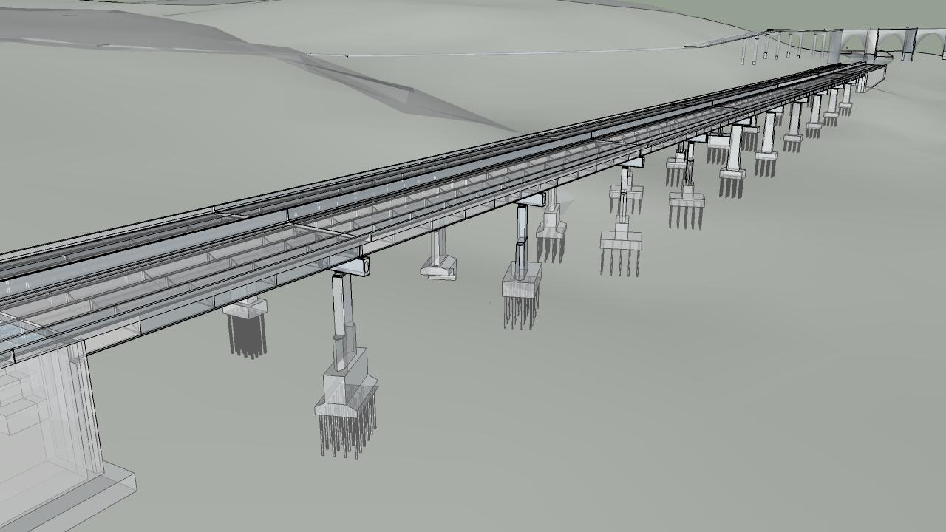
Example of SHM application in the Field
Vibration Investigation of multi-span viaduct
Superstructure: The structural type is steel multi-girder. Eight girders run longitudinally, resting on steel box girders that span transversely and are supported by the concrete piers. A reinforced concrete composite deck was cast in place, with a “raked” finish and no overlay.
Girder 1
Girder 8
Girder 9
Girder 10
There is no skew. The bridge has eleven spans. The maximum span length is 140’-0”. The out-to-out width is 76’-6”. Three spans are simply supported, while the remaining eight are two-span continuous. Each span has five interior rows of X-framed diaphragms and chevron diaphragms over the piers.

Slide 13
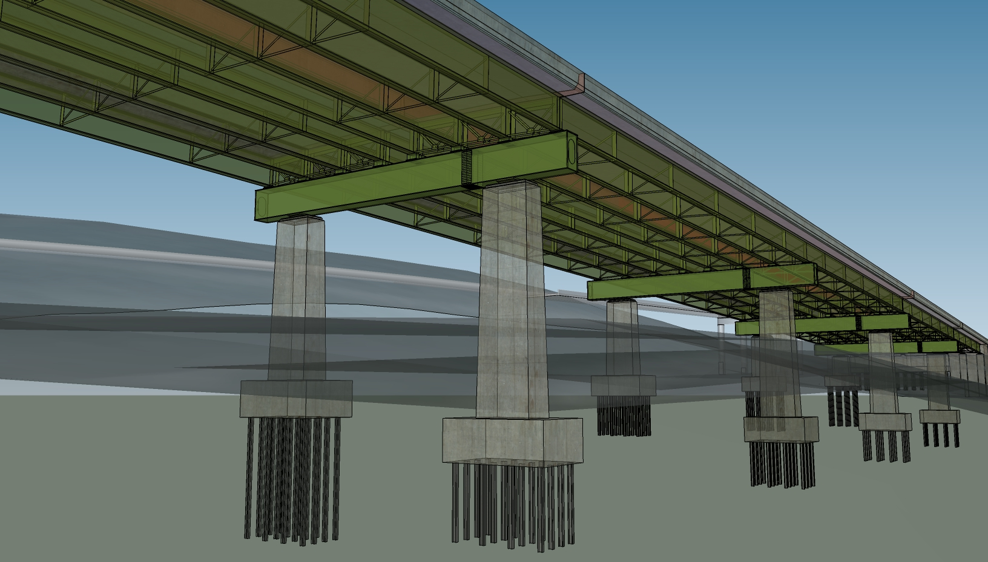
Example of SHM application in the Field
Vibration Investigation of multi-span viaduct
Substructure and Bearings: The concrete piers and abutments were constructed in 1952 and are all that remains of the original structure. They are supported by driven piles. Elastomeric bearing pads are installed on top of the piers and support the transverse box girders.

Slide 14
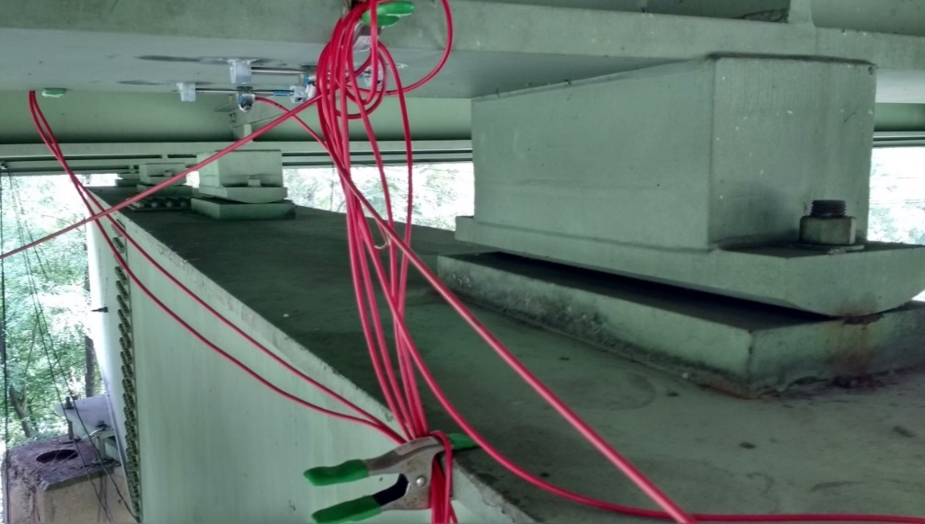
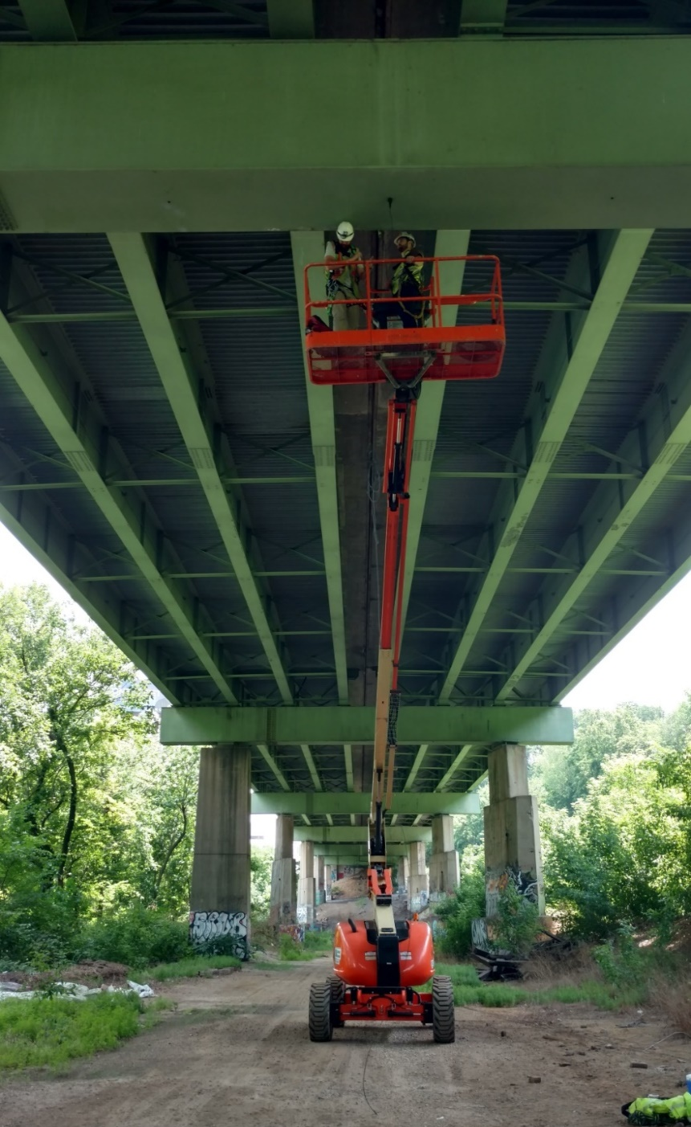
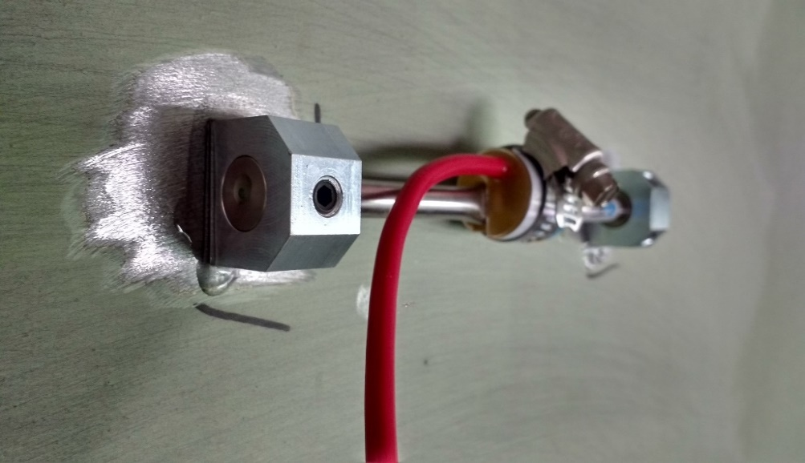
Example of SHM application in the Field
Vibration Investigation of multi-span viaduct
INSTRUMENTATION PLAN
30 Accelerometers
12 Strain Gauges
24 hours of data collected

Slide 15
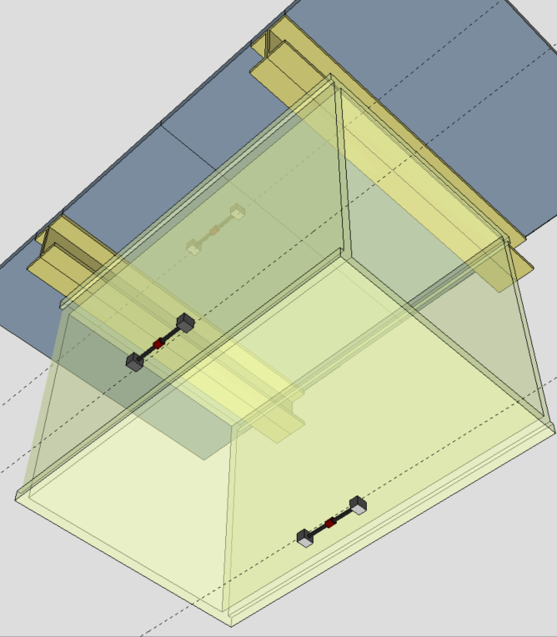
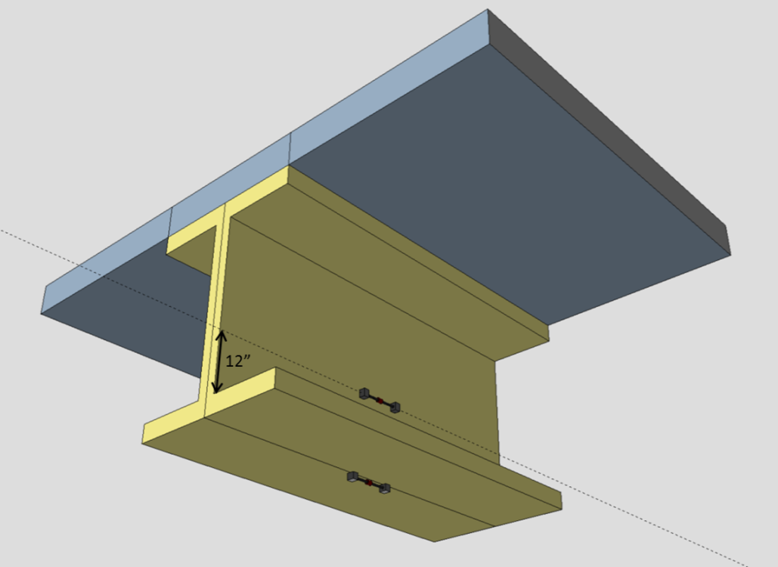
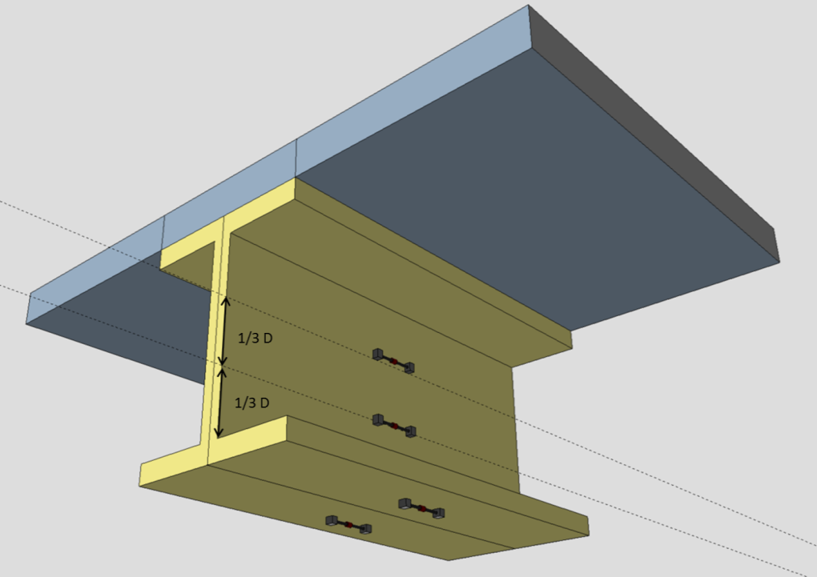
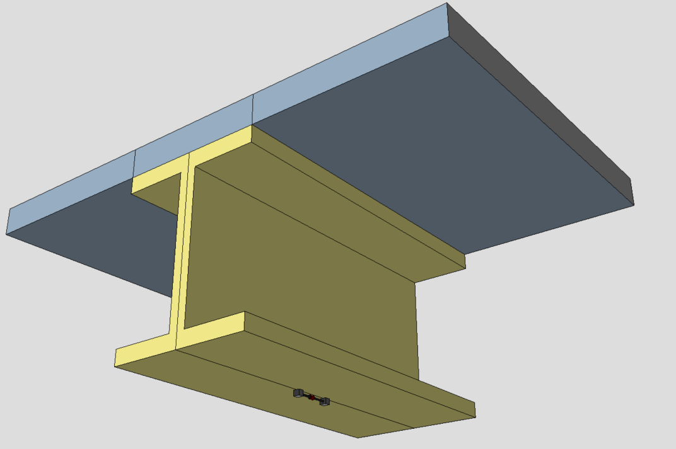
Example of SHM application in the Field
Vibration Investigation of multi-span viaduct
Span 7
Span 8
INSTRUMENTATION PLAN
12 Strain Gauges
1/4
Mid-span
3/4
1/4

Slide 16

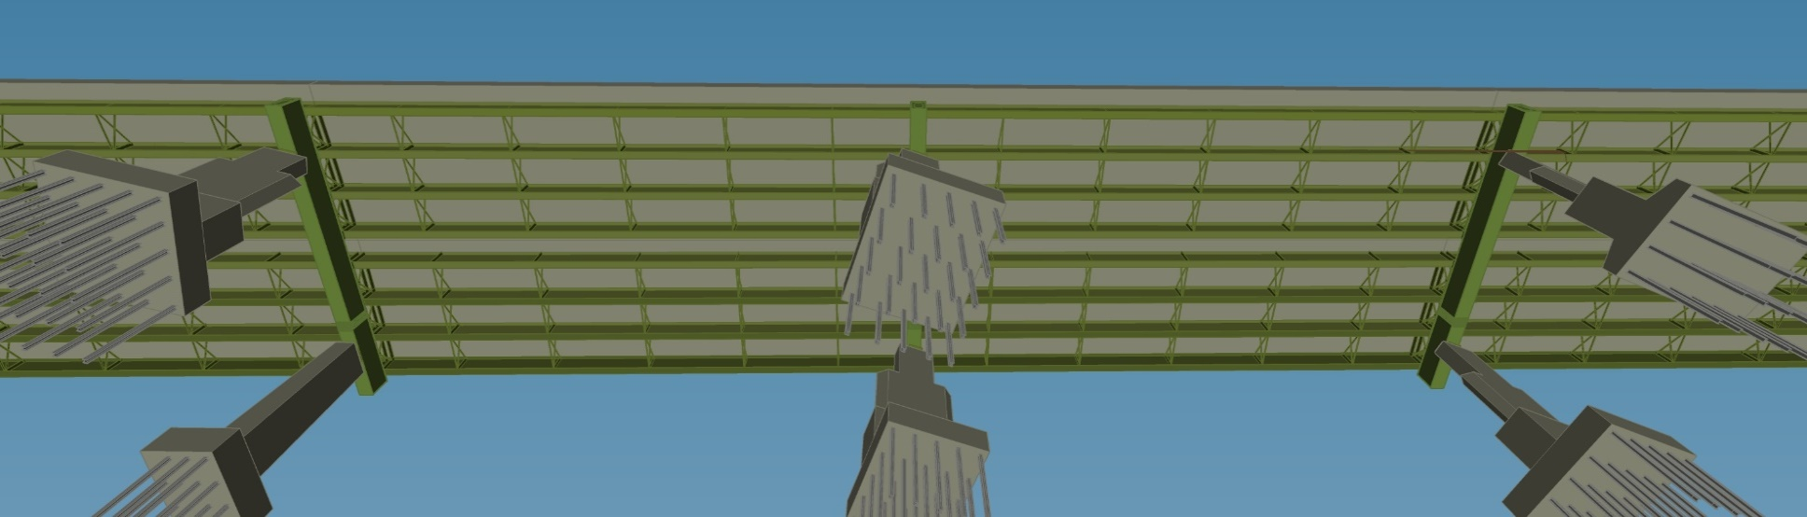

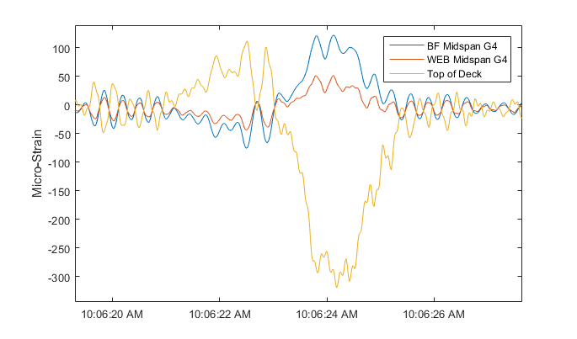
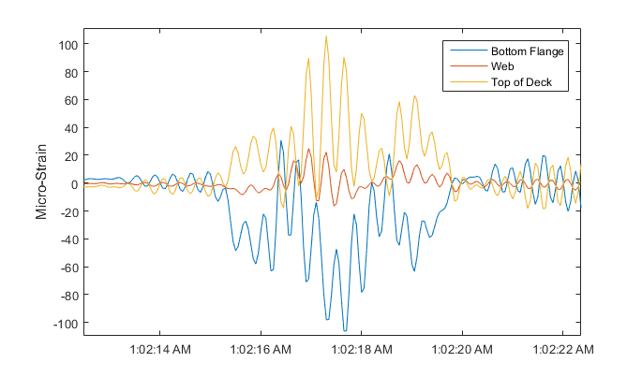
Example of SHM application in the Field:
Vibration Investigation of multi-span viaduct
Span 7
Span 8
Mid-span
The responses measured by the strain gauges confirm that the bridge is experiencing significant deflections under vibration.
Steel stress: 3 ksi
Concrete: 350 psi
Strain time histories at midspan
Strain time histories in neg. mom. region

Slide 17
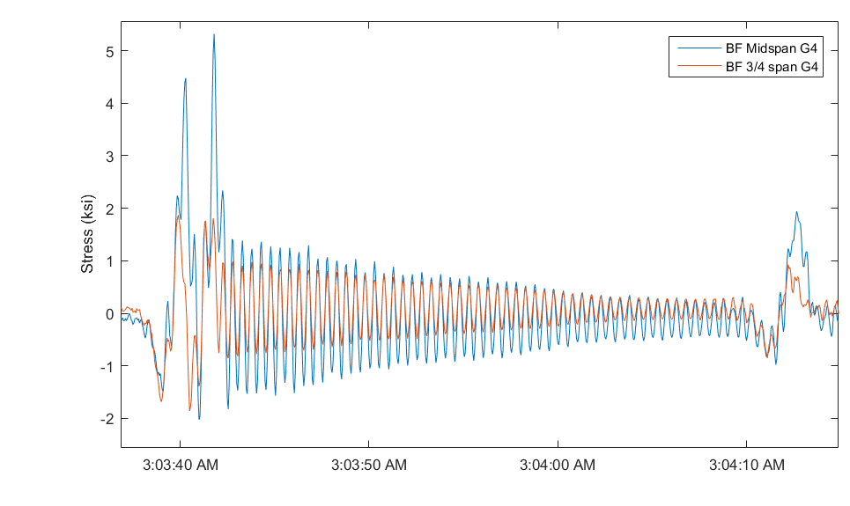
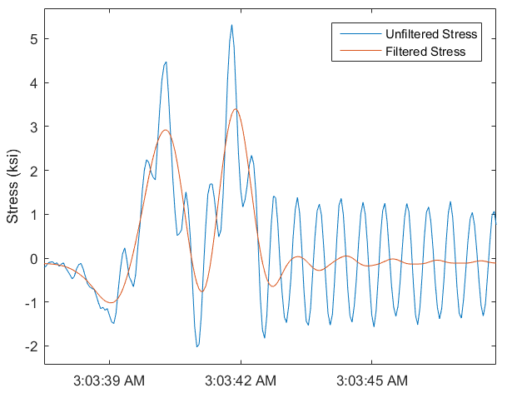
Example of SHM application in the Field:
Vibration Investigation of multi-span viaduct
50%
During a period of overnight monitoring, a large isolated truck passed over the bridge. A plot of the stress experienced by G4 at mid-span is presented above.
The bridge experienced large deflections (high operational stress)
Cyclic response which presents fatigue concerns with nearly 30 seconds of free decay once vibration has been induced and before another vehicle enters the bridge. This suggests that the structure has low damping.
To isolate dynamic response and static response, a low pass filter was applied to the data. The filtered response represents the static stress response. A dynamic amplification factor of 50% is estimated.

Slide 18
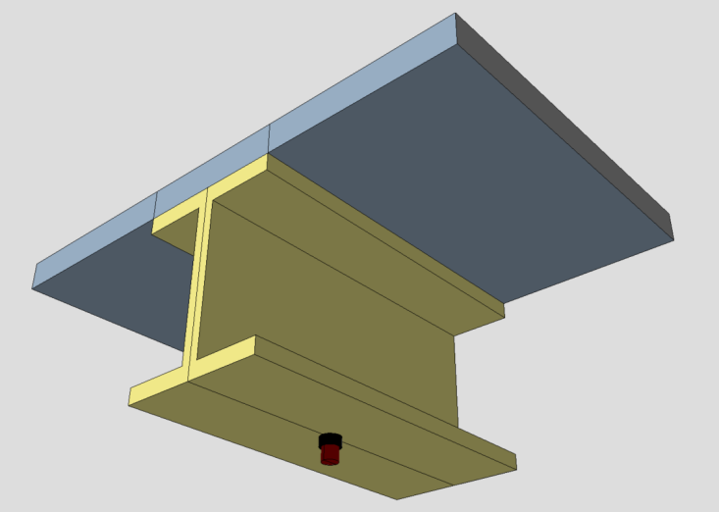
Example of SHM application in the Field
Vibration Investigation
of multi-span viaduct
Span 7
Span 8
INSTRUMENTATION PLAN
30 Accelerometers
1/4
Mid-span
3/4
1/4
Typical Accelerometer Installation
Longitudinal
3’
Vertical

Slide 19

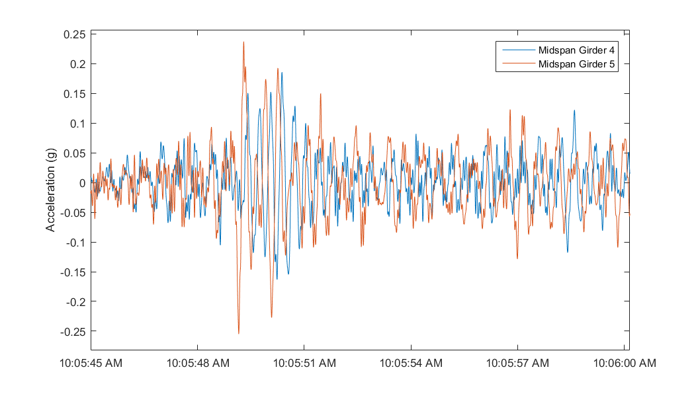
Example of SHM application in the Field:
Vibration Investigation of multi-span viaduct
The viaduct spans are experiencing high magnitudes of vibration at low frequencies (~ 0.25 g).
Span 7
Span 8
Mid-span
Acceleration time history during large event
Span 7
Span 8
1/4
Mid-span
3/4
1/4

Slide 20
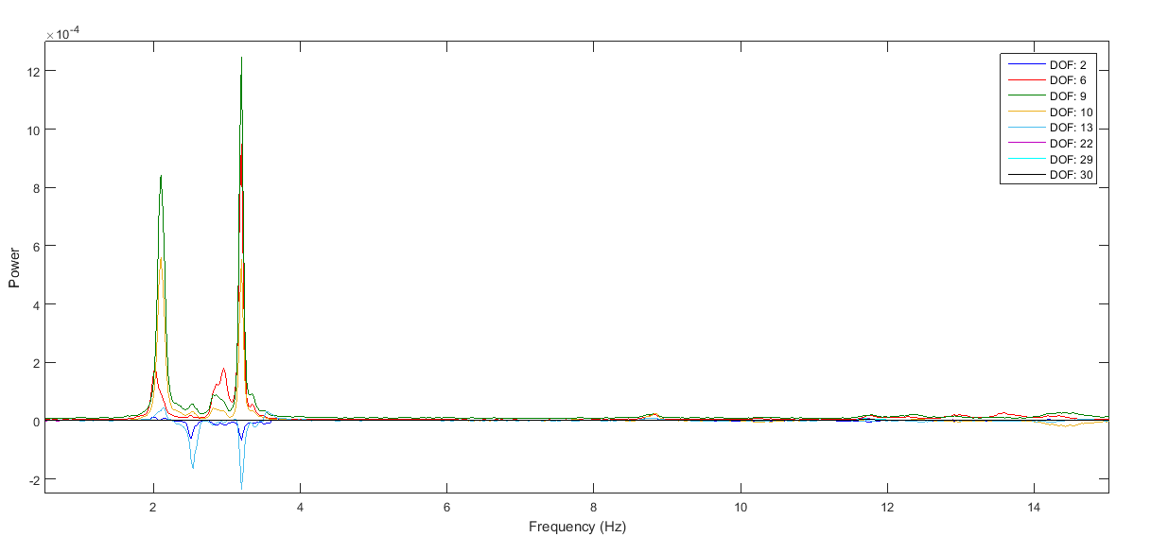
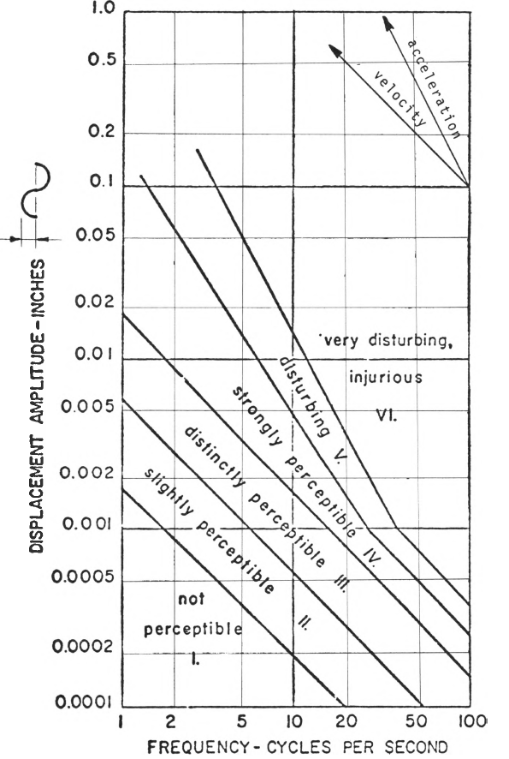
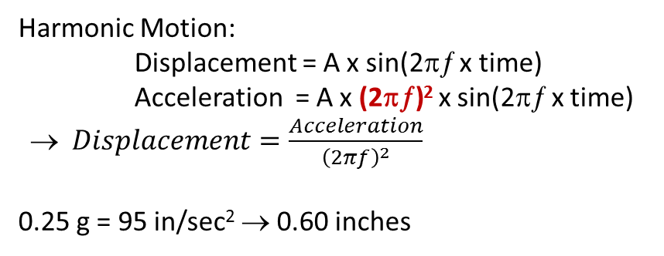
Example of SHM application in the Field:
Vibration Investigation of multi-span viaduct
Frequency content of Acceleration time histories recorded by different accelerometers
The deflection of the bridge is related to the magnitude of the acceleration and inversely related to the square of the frequency of the vibration.
This structure presents a unique combination where accelerations are leading to a large amount of displacement.
Harmonic Motion:
Displacement = A x sin(2πƒ x time)
Acceleration = A x (2πƒ)² x sin(2πƒ x time)
→ $Displacement=\frac{Acceleration}{{\left(2πf\right)}^{2}}$
0.25 g = 95 in/sec² → 0.60 inches

Slide 21
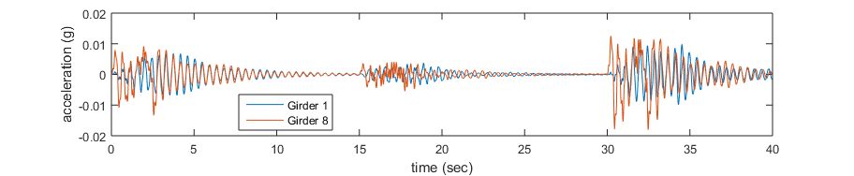
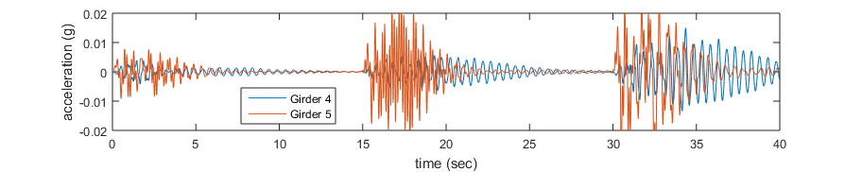
Example of SHM application in the Field:
Vibration Investigation of multi-span viaduct
Span 7
Non-Loaded Side
Loaded Side
Mid-span
The FE model was used to simulate trucks crossing on one side of the bridge through the use of a linear transient solver. The plots above show how much girders 1 and 4 are excited when loads are only applied on the span supported by girders 5 through 8.
An FFT performed on the simulated data shows that the modes that deform the cross-girder are those principally excited on the non-loaded side. Thus the cross girder is able to transmit vibrations from one side of the bridge to the other.

Slide 22
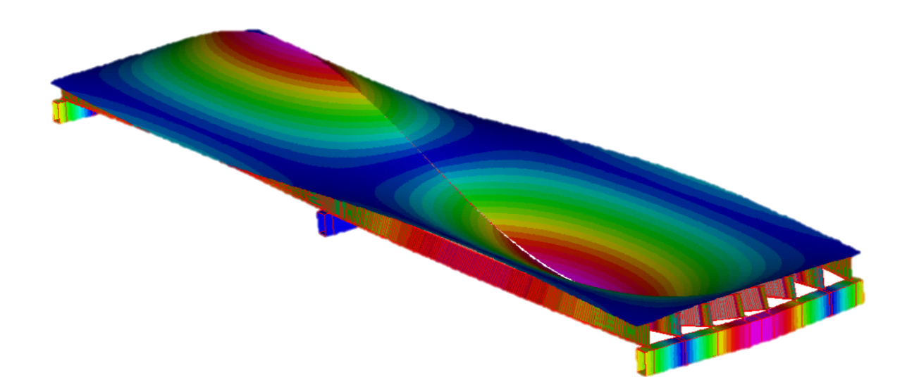
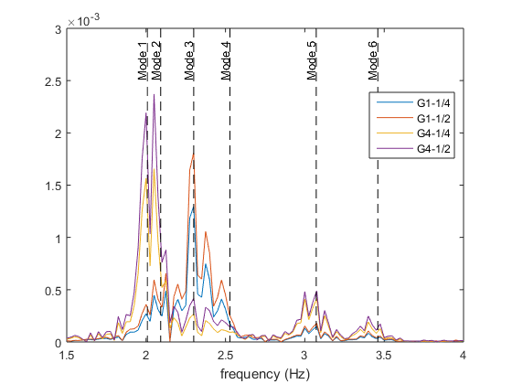
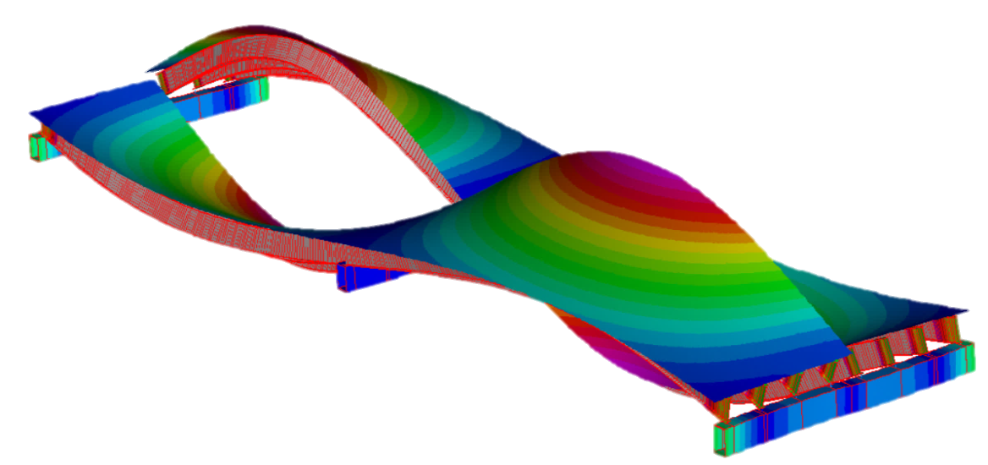
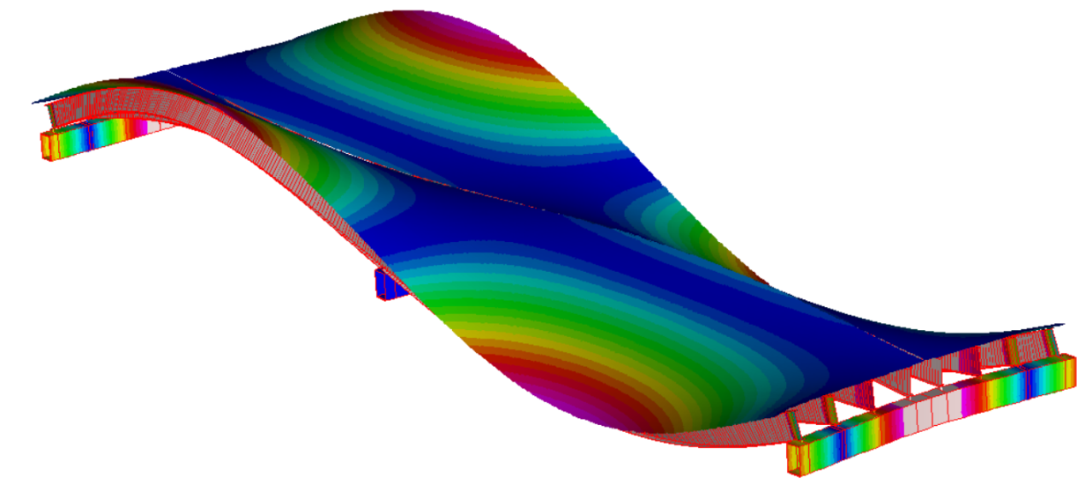
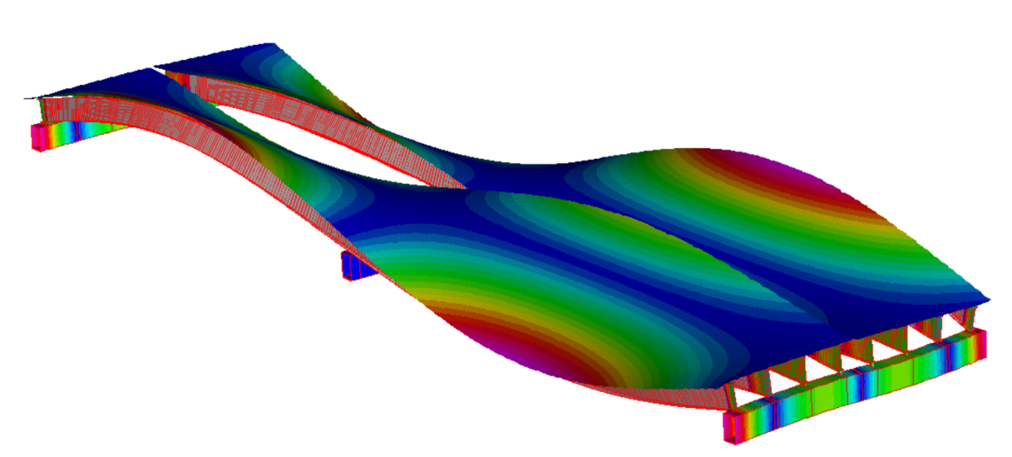
Example of SHM application in the Field:
Vibration Investigation of multi-span viaduct
Modes of Vibration Activated on Non-Loaded Side
Mode 1
Mode 2
Mode 3
Mode 4

Slide 23
Example of SHM application in the Field:
Vibration Investigation of multi-span viaduct
Several simplified FE models were created to study traffic scenarios and the structure’s response. The case models were made such that they had stiffness, mass and dynamic properties similar to the Viaduct. The following models were created:
Preliminary Results
2-span continuous | Single 72kip pt. mass
Two consecutive simple spans
Two-span continuous
Multiple consecutive simple spans (8 spans)
Multiple two-span continuous (8 spans)
The models were subjected to a variety of loading conditions, ranging from a single moving mass to multiple lanes of 100 vehicles with random spacing and different suspensions, damping and weights.
Preliminary results indicate that the initial conditions of the bridge (i.e. vibration induced by previous vehicles) has a significant impact on dynamic amplification.
Further simulations will include a variety of road profiles that may cause further amplification, including: over-camber, bumps at joints, and ramped approaches.
2-span continuous | Randomly spaced (6) 72kip pt. masses

Slide 24
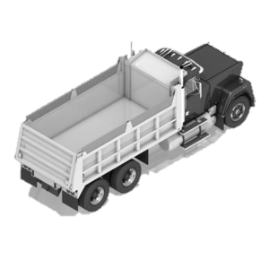
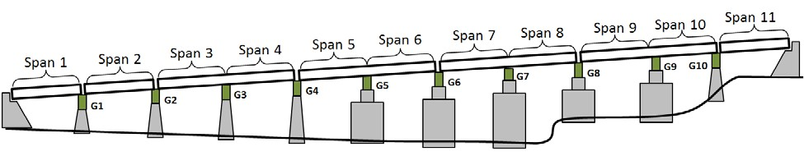
Example of SHM application in the Field:
Vibration Investigation of multi-span viaduct
Additional Testing
Another test was performed whereby the bridge, as well as a truck, was instrumented.
Questions:
What forces are delivered to the bridge from a moving truck.
How does the bridge respond to a large dynamic load
What vehicle/traffic conditions produce large amplifications
Suspension characteristics, vehicle speed, etc.
What structure/site conditions produce large amplifications
Over-camber, road profile, repeated spans, etc.
Objectives:
Capture Truck and Bridge acceleration synchronously.
Identify modes of vibration primarily activated by vehicle.
Identify driving scenarios that produce the greatest structural response.
Instrumentation Plan: 40 accelerometers + video
Span 2
Span 3
Span 4
Span 7
Span 8
DAQ
DAQ
DAQ

Slide 25
Example of SHM application in the Field:
Vibration Investigation of multi-span viaduct
Interim Conclusions:
Viaduct superstructures are indeed
vibrating with accelerations of up to 25%g.
Accelerations exceeding 10%g are
known as causing discomfort.
Viaduct stresses and displacements are within
the design code limits. Current rating factors are acceptable.
Measurements indicate that the deck is experiencing tensile stresses due to dynamic amplification of truck responses.
The efforts thus far have shown that the cross girder is transmitting vibrations from one side of the bridge to the other. This would result in motorists sitting in traffic on one side of the bridge to feel significant vibrations caused by free flowing traffic in the other direction.
Further measurements and analyses will be carried out to better understand the specific conditions in which large amplifications are induced.
Vibration amplitudes and amplifications in a bridge that satisfy the stiffness and strength requirements of the code is uncommon. SHM and FE Analysis are shown as valuable and in fact necessary for objectively measuring the responses and rating the bridge.

